Slide 1
CODE VIOLET
By Team MACHOK

Slide 2
CODE VIOLET
The city is under attack.
They are attacking our utopia.
Your job is to remove the resistance.
Your job is to eliminate.
Your job is to listen and do.
Keep your visor on, it’s a CODE VIOLET

Slide 3

CODE VIOLET
Trailer

Slide 4
CODE VIOLET
Meet the team!

Slide 5
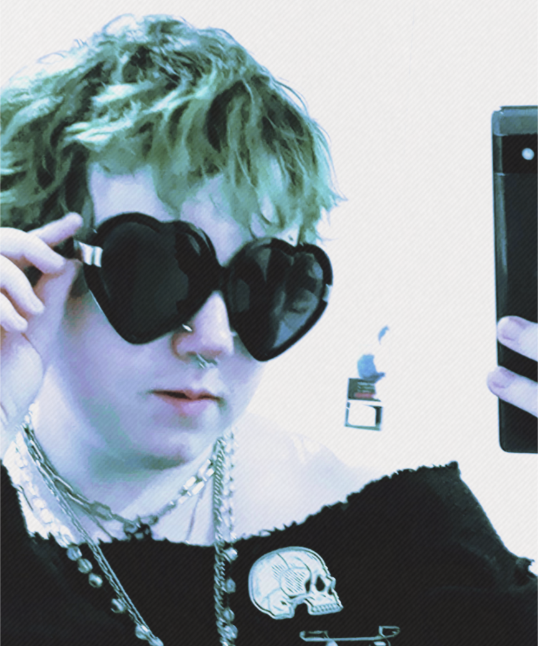
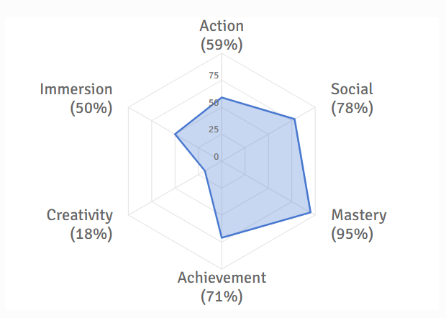
MICAH
Writer and (wannabe) artist!
My role was to create the narrative flow for CODE VIOLET along with designing assets and art for the game!
I mostly worked on background work outside of Unity, creating the GDD, artwork/assets, story and creating our promotional materials!

Slide 6
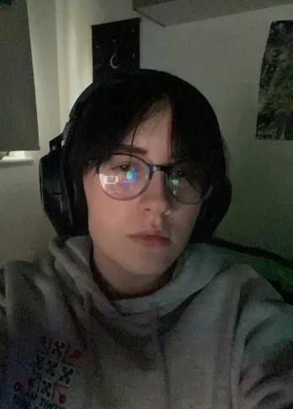
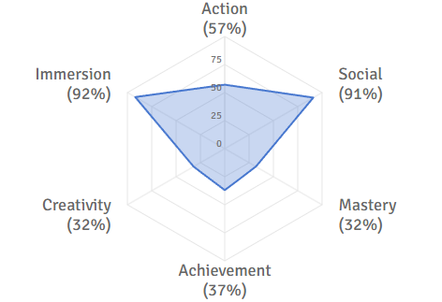
Ozzy
Level Designer and Asset Artist!
My main responsibilities were to design the first and second levels and help create a functional inventory system.
I also helped create and implement environment and player assets into the game

Slide 7
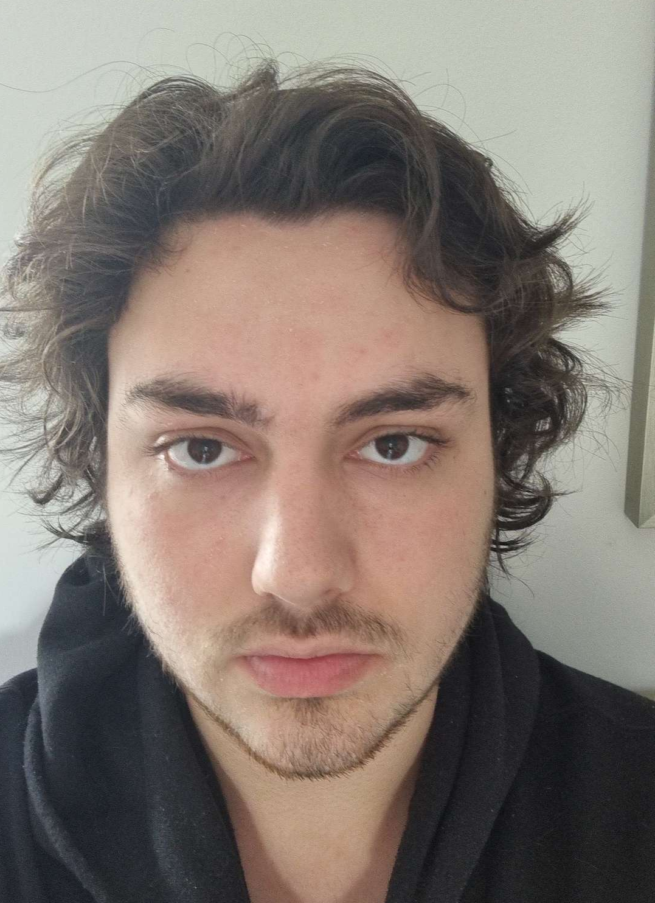
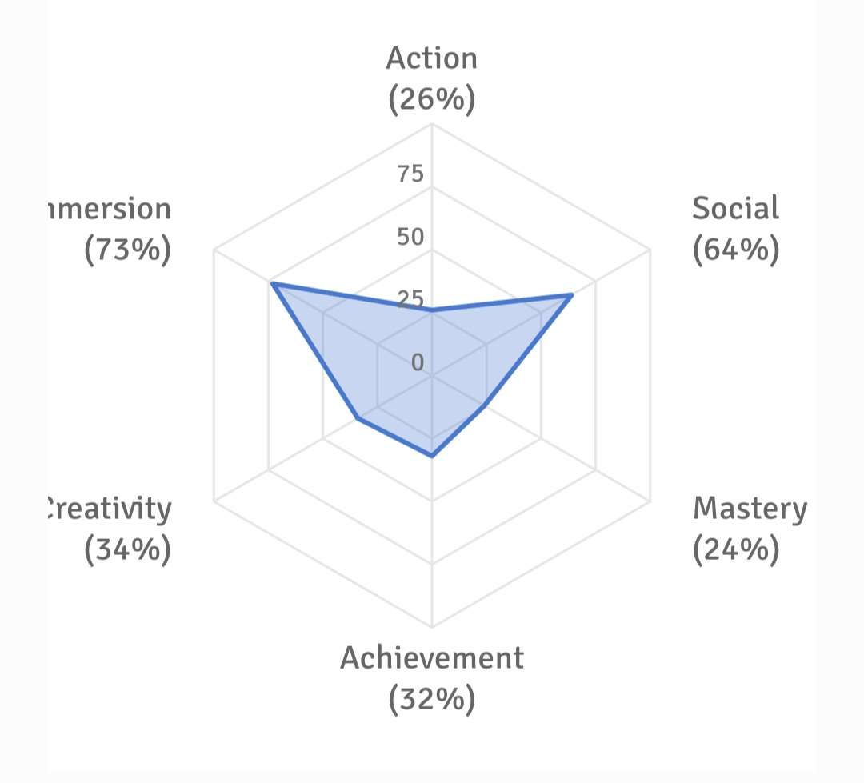
Herbie
Level Prototype Designer and UI Designer!
I was responsible for implementing UI (creating menus and the visual interface for player health) and prototyping an introductory level that was used for future reference in the level design of the game.

Slide 8
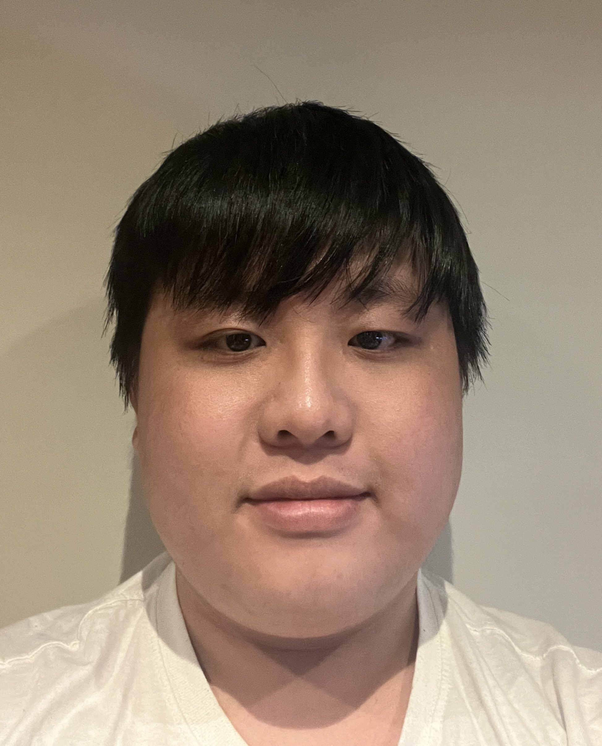
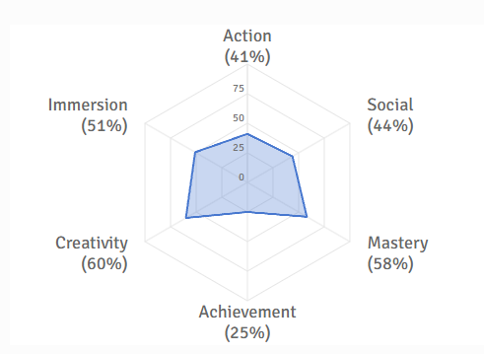
Cobi
Level Designer!
My role was to create a level for the game and to assist in creating assets for the levels.
I mostly spent time working with the other designers in creating the world that the players would traverse.

Slide 9
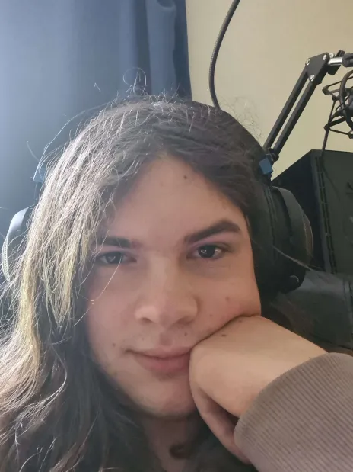
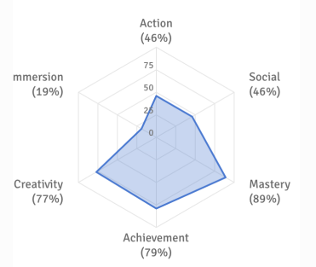
Ava
Programmer and Asset Artist!
I was responsible for prototyping combat and implementing enemy behaviours.
I was also responsible for creating enemy and level assets and helped other team members with debugging and the unity engine where needed.

Slide 10
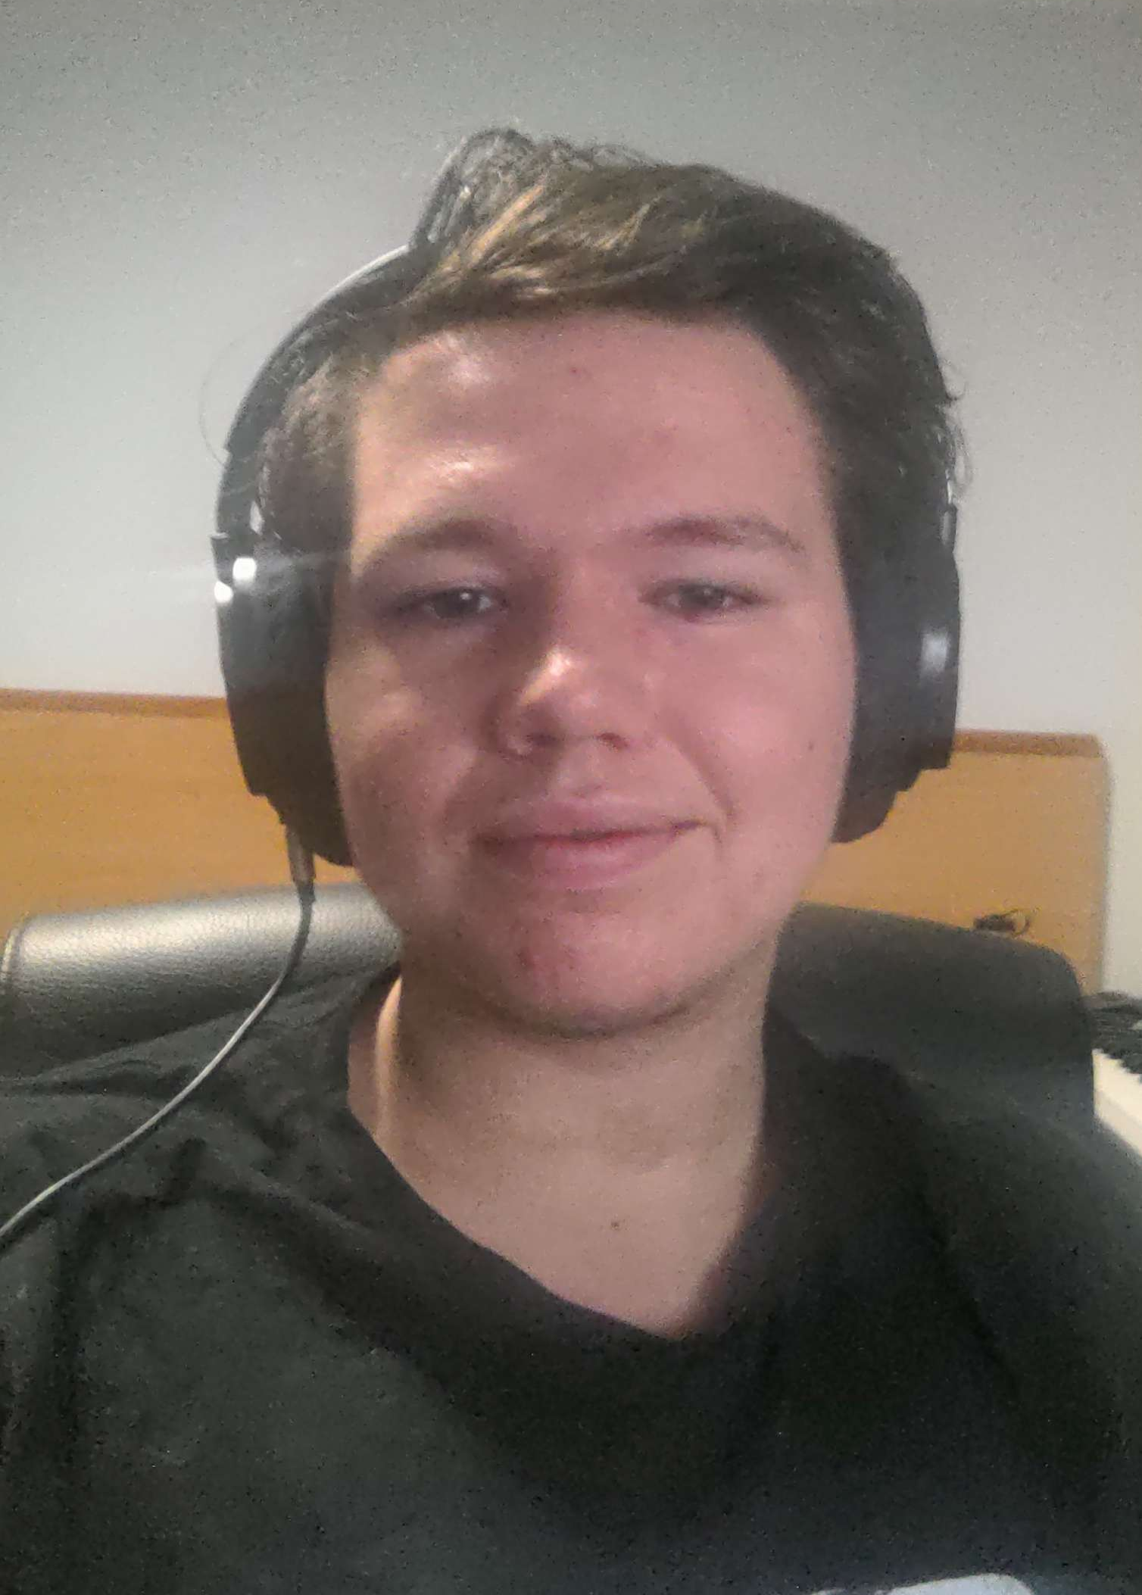
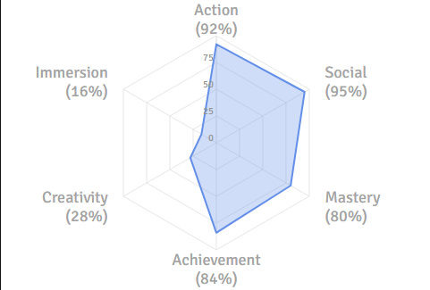
Kian
Programmer and Sound Designer!
I was responsible for the implementation and debugging of the core mechanics of the game, most notably the player controller, player combat.
I also helped with the enemy alert system and generally helped anyone where needed.

Slide 11
CODE VIOLET
Is a cyberpunk-metroidvania set in a hyper futuristic version of Earth.
The game centres around a nameless, faceless soldier – the player character.
The goal of the player is to explore and eliminate enemies.
The enemies are strange, almost censored figures raiding a building.
The player has been sent to deal with this raid.
In this slice we created in the past 10 weeks, we can show how gameplay and the game loop will look – with the implementation of core mechanics and visuals.

Slide 12
CODE VIOLET
Narrative
Underlying commentary on cyber-futurism, authoritarianism and militant propaganda/brainwashing
The lack of identity for the player can help them feel like it is more so them than a character they are following, however it also comments on how identity is stripped in militant worlds
The reality of the game is that the player is fighting against protesters, labelled as just “The Resistance”. This group is referred to in a very undefined manner in an attempt to hide the reality
The visor of the player’s helmet morphs their view into something deemed more appropriate – censoring the enemies and creating a ‘calm’ purple haze.
A Code Violet is a warning for a violent person

Slide 13
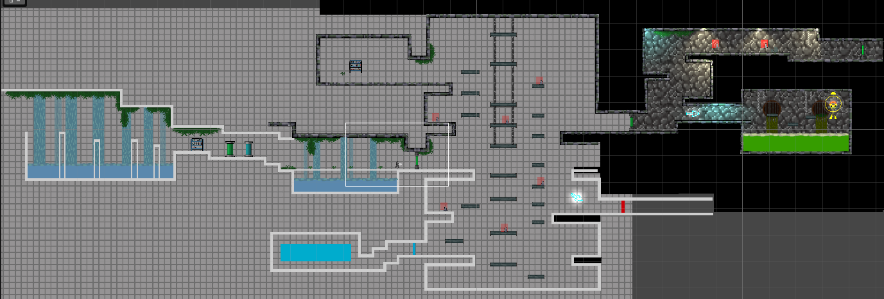
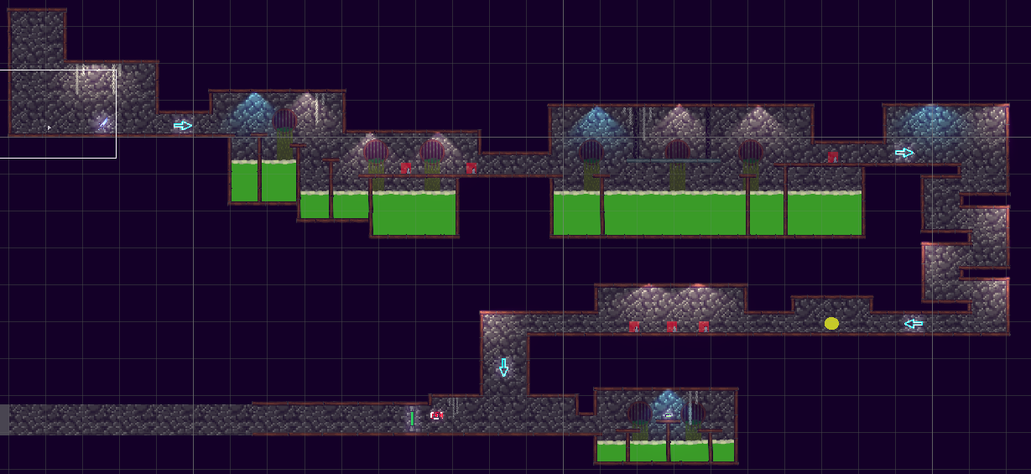
CODE VIOLET
Design
Our level design was very inspired by Hollow Knight
The different sections allow the slice to explore a few different environments

Slide 14
CODE VIOLET
Design
The enemies were kept simple, with basic ai – they’re there to be functional
Movement is kept flowy and smooth – player should be able to jump around and explore fun movement mechanics and combinations#
Free, fast and fun movement is one of the key features for a metroidvania and we tried to implement this into our own slice/demo!
The movement mechanics include: run, jump, wall jump, dash

Slide 15

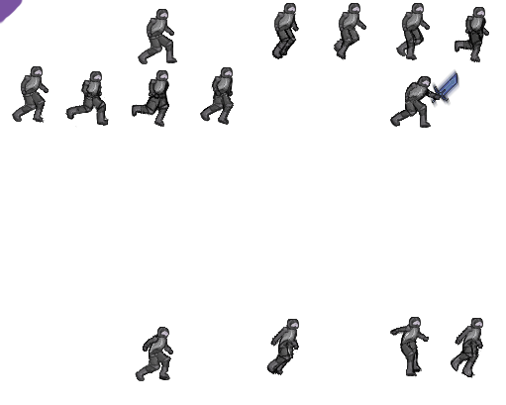
CODE VIOLET
Art
I (Micah) am not the greatest at animating, but I absolutely tried!!
We have a run cycle, jump and attack for the player character
The enemies (created by Ava) have a walk cycle and attack!

Slide 16
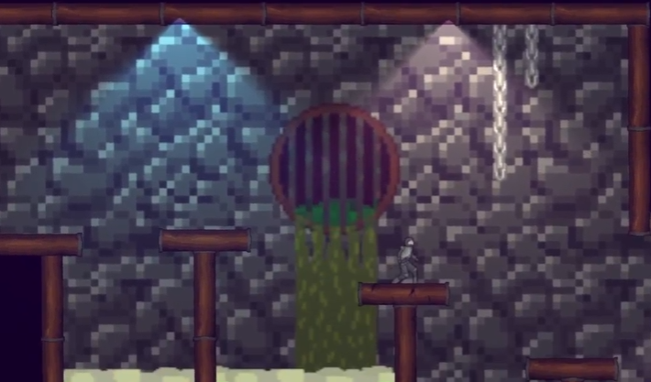
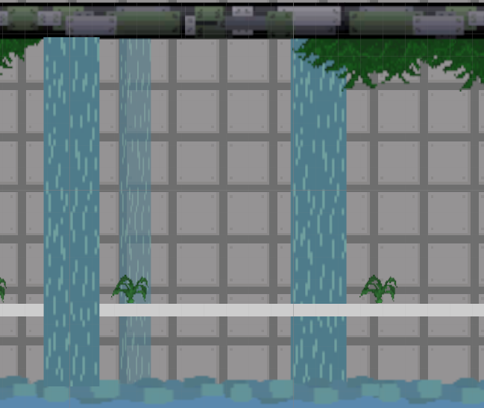
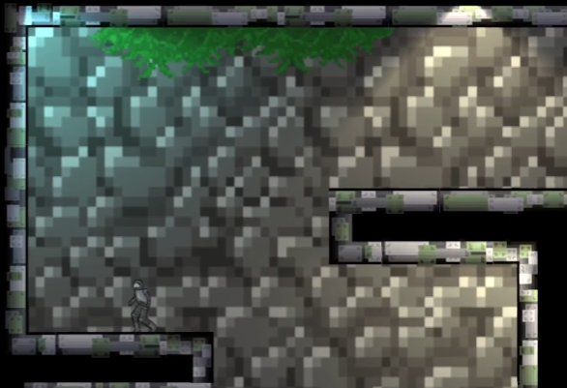
CODE VIOLET
Art
The environment assets were worked on by almost everyone (primarily Ava, Micah, Cobi and Ozzy) for three separate scenes!

Slide 17
CODE VIOLET
Our Process
Our concept stage was incredibly short to be honest, we all decided quite quickly what we wanted to work on
It’s quite lucky that most of us enjoyed metroidvanias, rouge-likes and rouge-lites
Our split in specialisms were quite fortunate too so we had a good variety of skills
Everyone picked up work where possible to help each other out and communication was key to our game slice/demo turning out functional!

Slide 18
CODE VIOLET
Thank You!!!
Questions?

